Slide 1

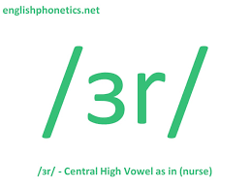
Sociophonetic study of NURSE vowels in Nigerian English
LING 2020: Data Science Research in Linguistics
Oluwasegun Amoniyan

Slide 2
Motivation for the study
NURSE vowel means vowels produced in similarity or variation to the mid-central vowel [ɜ] as [nɜrs], [nɛs]...
The existing literature contains information about NURSE vowel production, particularly in the inner circle of English. However, their findings often overgeneralize other Englishes without providing supporting evidence. The (current) study will investigate the phenomenon in the outer circle of English and provide a balanced description of the variation that characterizes the NURSE vowel.
02

Slide 3
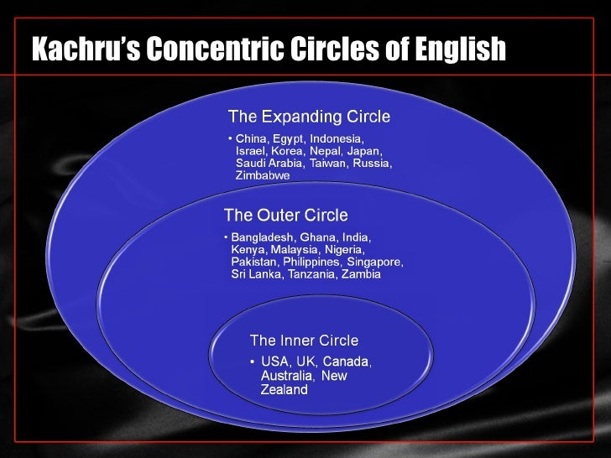
Background and Review
Background
NURSE vowels have received scholarly attention in different varieties (especially in the inner circle) of English (e.g., American English, British English, New Zealand English). Their results are similar (not absolutely).
Review
Studies of NURSE vowel variation in different types of English, spoken alone or with a partner, show that the vowels can merge (as a centralized vowel) or keep their three-way contrast as [ɪ], [ɛ], and [ʌ], with rhotacization occurring in different ways. These realizations are influenced by social (e.g., gender, age) and linguistic factors (e.g., speech style) (Li et. al., 2021; Maclagan et. al., 2017; Mayr, 2010; Mesthrie & Chevalier, 2014; Watson & Clark, 2013).
03

Slide 4

Research gap
However, very little is known about NURSE vowel variation in New Englishes like Nigerian English (NE), which exists in a rich multilingual context with regional varieties (i.e., Hausa, Igbo, Yoruba) and over 250 ethnic groups. This study bridges the gap in the knowledge of NURSE vowel production in Englishes.
What are NURSE vowel productions in NE?
What possible factors determine variation in NURSE vowel production in NE?
To what extent do phonetic features describe the vowel identity of NURSE vowels?
04

Slide 5
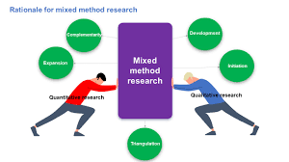
Methodology

Slide 6
Data ICE-Nigeria
The data for this study were drawn from the International Corpus of English Nigeria (ICE-Nig). The corpus contains 1,010,382 collections, with 609,586 spoken words and 400,796 written words (Wunder et al., 2010). The sound and text files were downloaded and uploaded to WebMAUS for forced alignment. The forced-aligned speech samples were manually adjusted on the fourth tier on Praat.
16 sound files
two speech styles (broadcast talk - 5 and broadcast news - 10)
All speakers in this study used NE as second language participants
Vary by gender (male vs female), ethnicity, speech style, Profession, and age
06

Slide 7
Fast Track
Fast Track reports 5 formant levels (f1, f2, f3, f4, f5), with the lowest as 4700Hz and the highest as 7550Hz. The algorithm generates 20 formants for undistorted formants and selects a winner after comparison with other possible formant outputs. Unlike previous studies of NURSE vowels that implemented midpoint and three-point vowel measurement, Fast Track would enable me to account for formant trajectories. This algorithm has better formant representation than midpoint and three-point vowel measurement. Samples
segment info nurse aggregate nurse social
Data Wrangling
remove uninformative columns
adding and renaming some columns
categorization of age group, profession
joining data frames
07

Slide 8

Vowel normalization
Bark difference metrics
to eliminate physiological differences among speakers
to preserve socio-linguistic/dialectal/cross-linguistic differences in vowel quality
to preserve phonological distinctions among vowels, navigate
08

Slide 9
Statistical Analysis
The raw files were analyzed using Mixed effects regression with tidyverse and lme4 to account for linguistic, ethnic, and social variables that determine (or may contribute to) variation in Nigerian English NURSE vowels.
09

Slide 10
Analysis

Slide 11
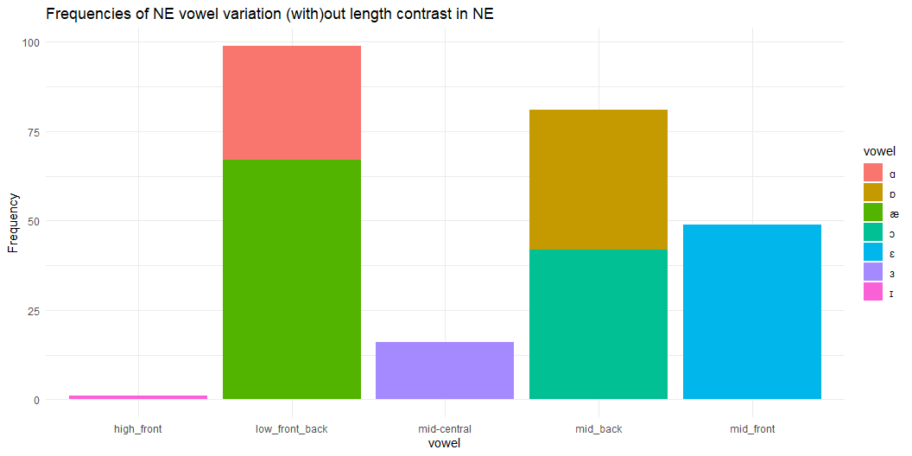
NURSE vowel productions in NE
11
Notes:
Explanation
Different vowels for NURSE vowels
Without length contrast, which is more frequent in the variety; nurse as [nas]
This explains variation that do not trigger misunderstanding of NURSE

Slide 12
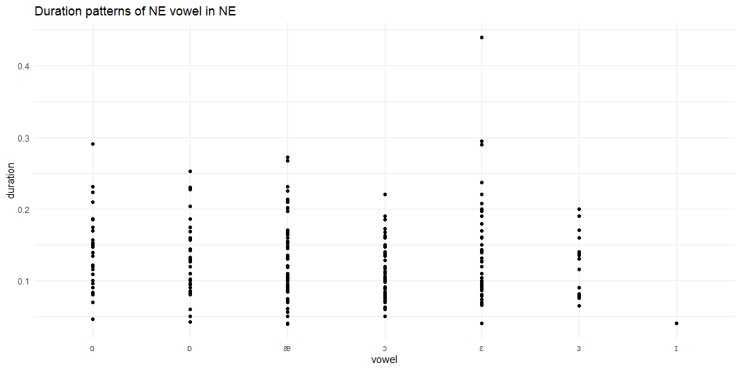
Duration patterns for NURSE vowels in NE
This tests if there is a merger by duration (not by vowel space as largely reported in the literature)
12

Slide 13
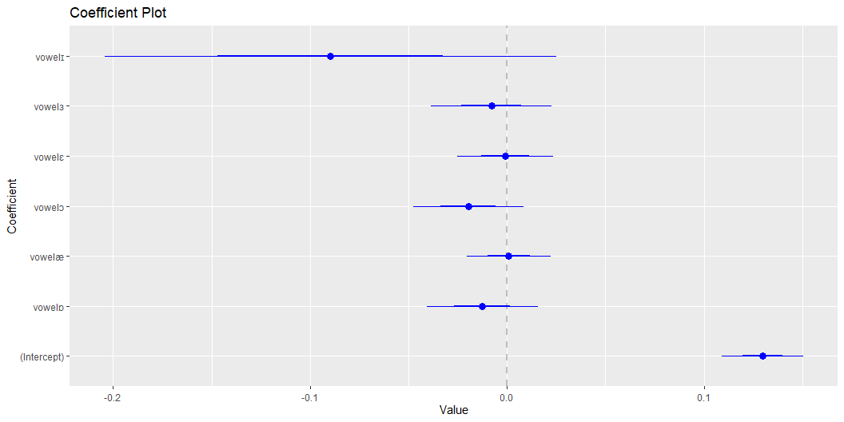
Segment info (Is duration significant?)
Regression analysis of duration
Duration does not significantly determine variance in NURSE vowels. The model, the results show that the realization of the NURSE vowel as a low back vowel ([ɑ]) was statistically significantly different in duration from other NURSE vowels (intercept = 0.13, 95%, t(237) = 12.54, p < .001).
13

Slide 14
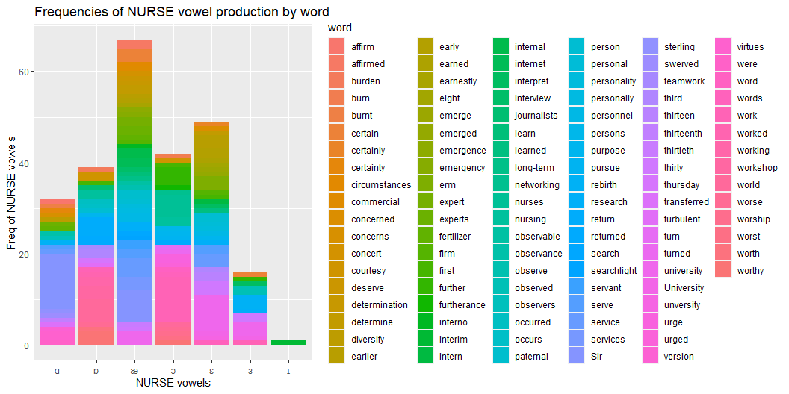
Phonological effect on NURSE vowel
One of the hypotheses identifies the effect of the phonological environment on NURSE vowel production in NE.
14

Slide 15
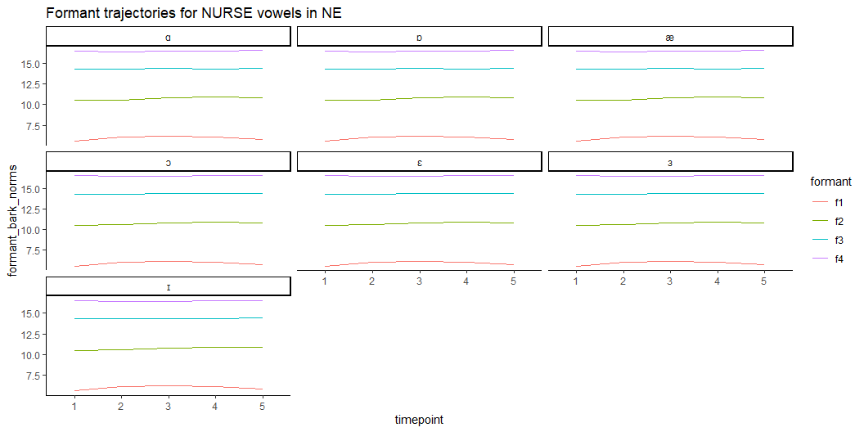
NURSE vowel formant trajectories
15

Slide 16
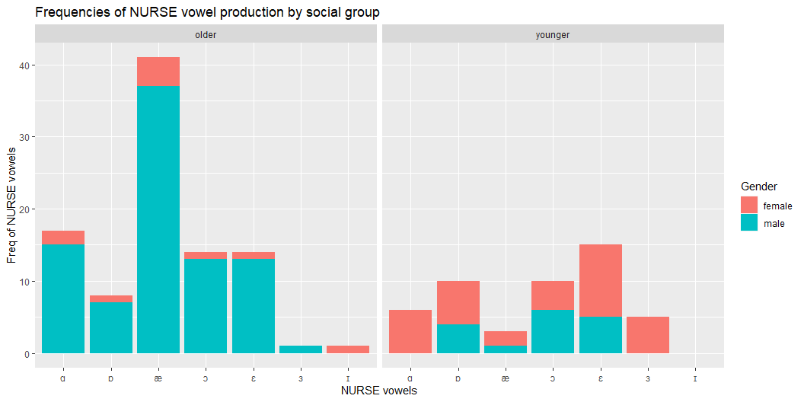
NURSE vowel production in NE by age and gender
16

Slide 17
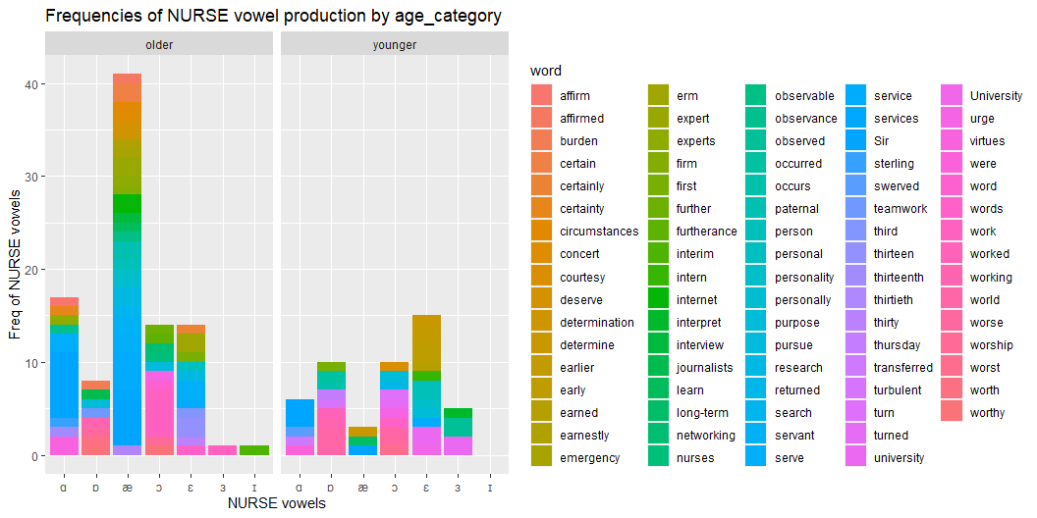
NURSE vowel determinant by age and gender
17

Slide 18
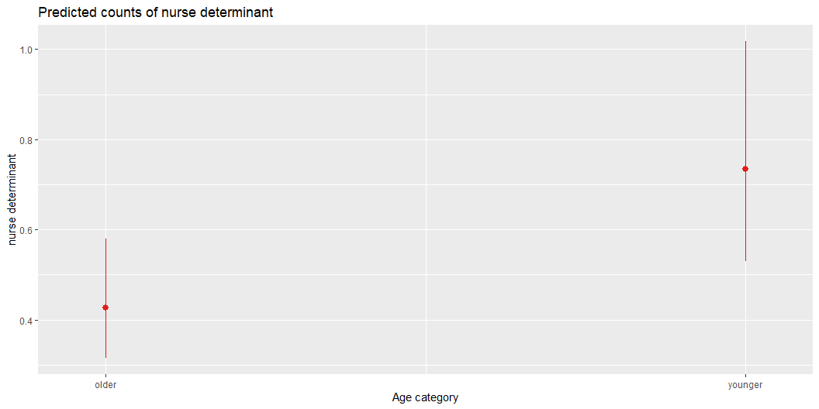
NURSE vowel determinant in NE by age and gender
Age(significant), but gender(not sig, no convergence)
18

Slide 19
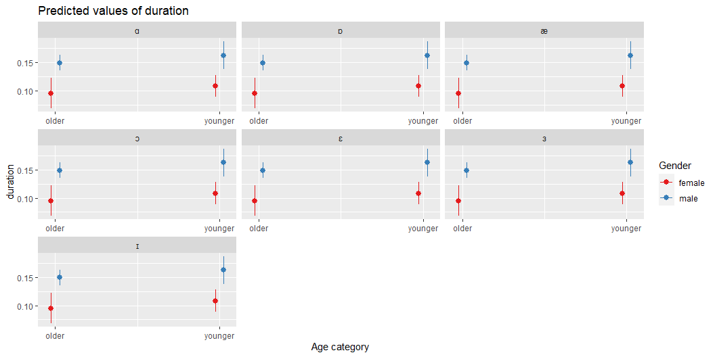
Duration patterns of NURSE vowel production in NE by age and gender
Significant by gender (alone)
19

Slide 20
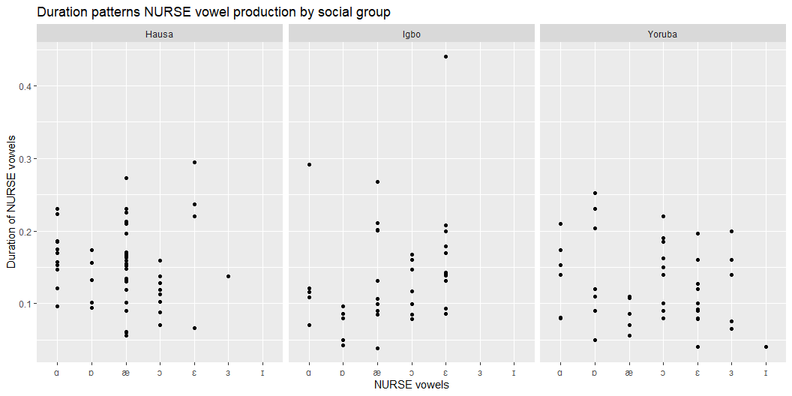
NURSE vowel production by ethnicity
20

Slide 21
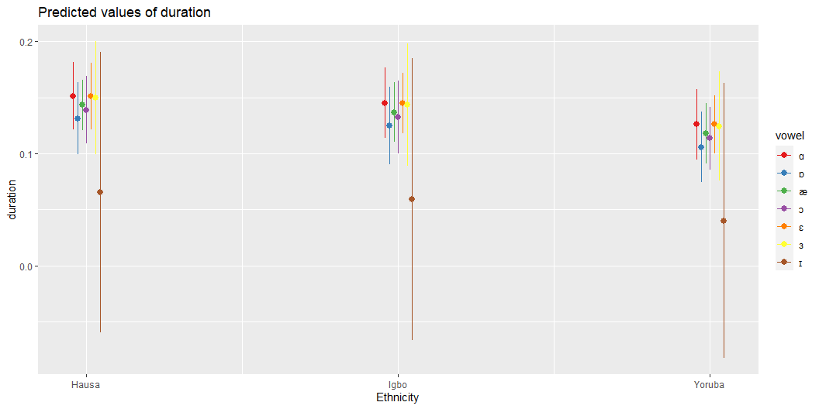
NURSE vowel production by ethnicity (regression)
21

Slide 22
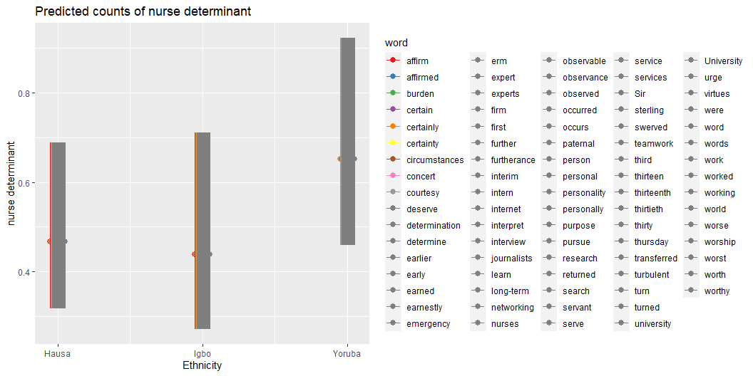
NURSE vowel determinant by ethnicity
22

Slide 23
RQ evaluation
The production of NURSE vowels in Nigerian English varies across linguistic (vowel production and phonological context), ethnicity/languages (Hausa, Igbo, and Yoruba), and sociolinguistic (age, gender) factors. Additionally, these productions do not follow a categorical or gradient pattern. As a result, the strategies for NURSE vowel variation in NE differ from the inner circle of the English variety.
23

Slide 24
Discussion and future investigation
Evidently, there are variations in NURSE vowels other than categorical or gradient r-presence. If we included other speech styles later, the variation might exceed what we observed.
My findings are similar to those of previous studies, which found that gender, age, style/register/community of practice, and geographical location could affect NURSE vowel production. (Li et. al., 2021; Maclagan et. al., 2017; Mayr, 2010; Mesthrie & Chevalier, 2014; Watson & Clark, 2013)
My analysis is limited (just 246 data points), so I will add more speech samples before generalization.
As my interest in sociophonetics grows, I will continue to learn R packages and skills in data science for data management, presentation, and accessibility.
24

Slide 25
References
Li, Z., Gut, U., & Schützler, O. (2021). nurse Vowels in Scottish Standard English: Still Distinct or Merged? Journal of English Linguistics, 49(3), 305-330.
Maclagan, M., Watson, C. I., Harlow, R., King, J., & Keegan, P. (2017). Investigating the sound change in the New Zealand English nurse vowel/ᴈ. Australian Journal of Linguistics, 37(4), 465-485.
Mayr, R. (2010). What exactly is a front-rounded vowel? An acoustic and articulatory investigation of the NURSE vowel in South Wales English. Journal of the International Phonetic Association, 40(1), 93-112.
Mesthrie, R., & Chevalier, A. (2014). Sociophonetics and the Indian diaspora: The NURSE vowel and other selected features in South African Indian English. In English in the Indian diaspora (pp. 85-104). John Benjamins.
25

